Slide 1
Digital Portfolio
STUDENT NAME: NITHESH.J
REGISTER NO AND NMID: autunm11024ca112
DEPARTMENT: B.C.A
COLLEGE: University of Madras

Slide 2
PROJECT TITLE
PORTFOLIO FOR WEB DEVELOPMENT

Slide 3


AGENDA
Problem Statement
Project Overview
End Users
Tools and Technologies
Portfolio design and Layout
Features and Functionality
Results and Screenshots
Conclusion
Github Link
3/21/2024 Annual Review

Slide 4

PROBLEM STATEMENT
Many individuals struggle to showcase their skills, projects, and achievements in a professional and engaging manner.
Traditional resumes are limited in interactivity and design.
There is a need for a personal portfolio website that highlights skills and projects effectively.

Slide 5

PROJECT OVERVIEW
Developed a responsive portfolio website using HTML, CSS, and JavaScript.
The portfolio showcases personal information, skills, projects, and contact details.
Designed with clean UI/UX principles and optimized for desktop and mobile.

Slide 6

WHO ARE THE END USERS?
Recruiters & Employers – to evaluate skills and past work.
Clients – to check expertise before collaboration.
Peers/Community – for networking and sharing ideas.
Personal Branding – for online visibility and self-promotion.

Slide 7
TOOLS AND TECHNIQUES
HTML5 – Structure of the website.
CSS3 – Styling and responsive design.
JavaScript – Interactivity (form validation, animations).
Git & GitHub – Version control and project hosting.
VS Code – Development environment.

Slide 8
POTFOLIO DESIGN AND LAYOUT
Header – Name, tagline, navigation menu.
Sections – About, Skills, Projects, Contact.
Projects Section – Showcases real examples with descriptions.
Footer – Social links (LinkedIn, GitHub, Email).
Responsive Layout – Works on both desktop and mobile.
8

Slide 9
FEATURES AND FUNCTIONALITY
Smooth scrolling navigation.
Responsive design for mobile & desktop.
Interactive project cards.
Contact form with validation.
Integrated social media & GitHub links.
Simple and clean UI for better user experience.

Slide 10
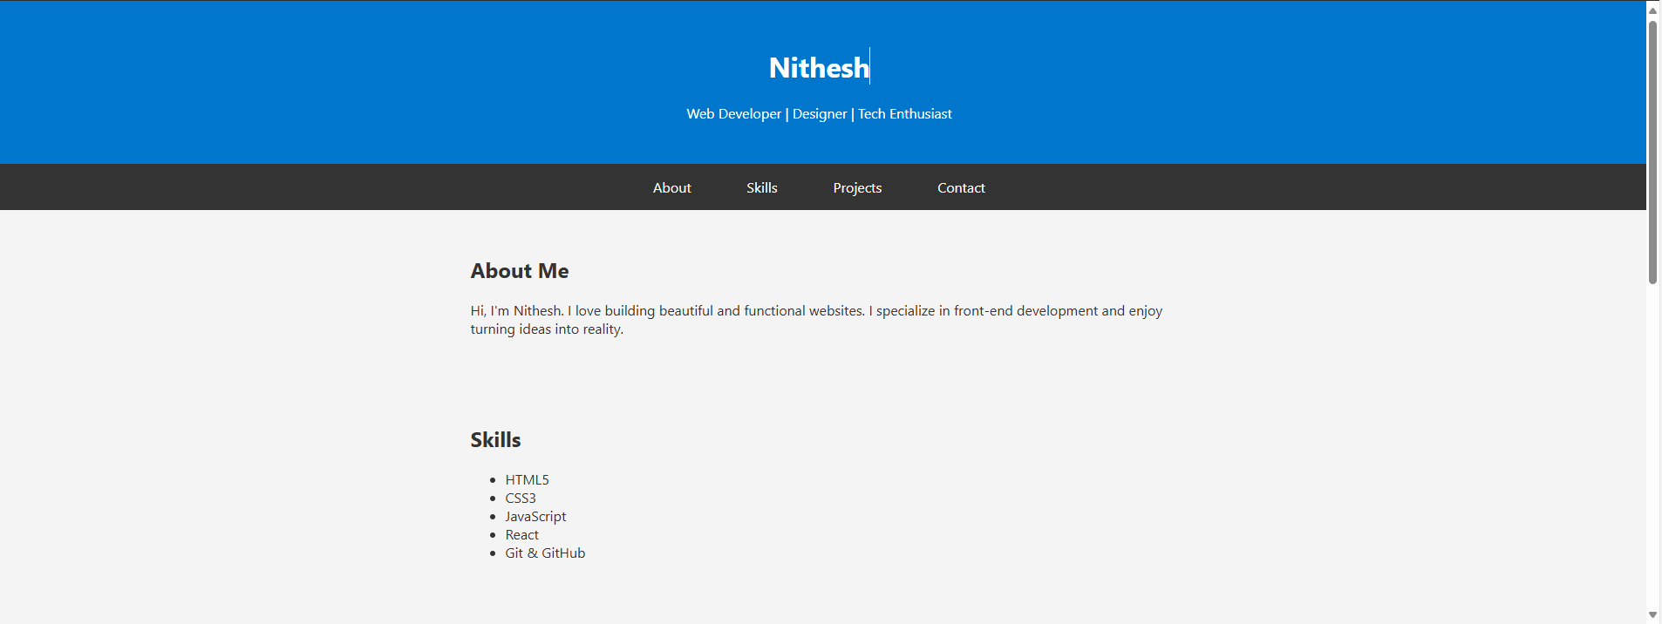
RESULTS AND SCREENSHOTS
3/21/2024 Annual Review
10

Slide 11
CONCLUSION
The portfolio project enhances personal branding.
Provides a professional platform to showcase work.
Demonstrates skills in front-end development.
Serves as a base for future improvements (blogs, backend integration).
11

Slide 12
Github Link
https://github.com/jnithesh2007-cpu/TNSDC-FWD-DP.git

